Slide 1
Project SciKey

Slide 2
Introduction
This project aims to identify keywords that describe the content of each publication. Keyword suggestions will be made using current AI tools based on LLM.
The focus is on building a realistic and functional prototype within the available timeline
(~9 weeks).

Slide 3
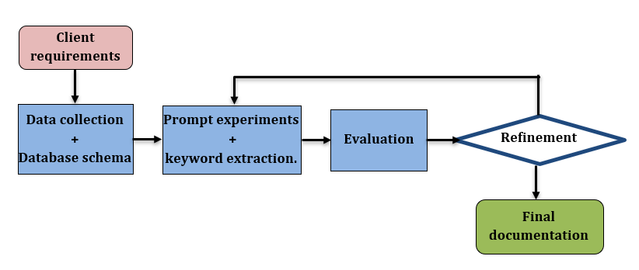
Project Workflow Overview

Slide 4
Data Collection
Source: Publications will be retrieved using the HAL API (or other client-approved repositories). - Format: Data will initially be stored in CSV/JSON files for preprocessing. - Sample Size: Between 100–200 documents will be selected. - Selection Criteria: Ensure variety across document types (articles, conference papers, books, etc.) and structures (with/without keywords, with multiple authors, etc.).
-How should we handle different versions of the same paper?

Slide 5
Database Schema
Core tables: • Documents → title, abstract, journal info, docid, producedDate_tdate, submittedDate_tdate, language_s • Authors → first name, last name, initials, position, affiliations.
Journal->Journallssn_s, journalTitle_s • Affiliations → department, institution, location, authOrganismId_i, authOrganism_s • Keywords → both author-provided and LLM-generated. • Identifiers → docid,hallid_s,doild_sDOI, ISBN
• References →cited works with structured fields - Special considerations: • Allow unlimited authors per document. • Allow multiple affiliations per author. • Journal metadata should capture volume, issue, and pages.

Slide 6
Keyword Extraction Methodology
- Keywords describing the content of each publication based on their title and abstract or the full document?
Author Keywords: Always preserved as provided. - LLM Keywords. - Prompt Design: Iterative testing of different prompts to ensure relevant keyword extraction. - Pending client decision: Should LLM-generated and author keywords be merged, or stored separately?
- How many keywords per document are expected – fixed number or variable depending on the paper?

Slide 7
Evaluation
- Possible checks: • Compare overlap between author vs. LLM keywords. • Consider external tools (e.g., ScanR).

Slide 8
Final documentation
Technical report (methodology, results, limitations, recommendations).
Codes used at each stage (hosted in GitHub)

